Slide 1
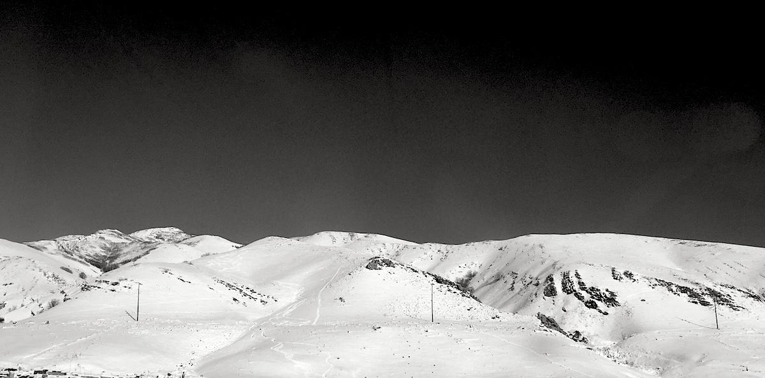
Genome arithmetic with bedtools.
Applied Computational Genomics, Lecture 17
https://github.com/quinlan-lab/applied-computational-genomics
Aaron Quinlan
Departments of Human Genetics and Biomedical Informatics
USTAR Center for Genetic Discovery
University of Utah
quinlanlab.org

Slide 2
Getting a bit more sophisticated. Mini programming!!!
Report lines if they are the 100th through the 200th lines in the file OR (||) they are from chr22
awk '(NR>=100 && NR <= 200) || ($1 == "chr22")' cpg.bed

Slide 3
Do some computation and report the results
Print the BED record followed by the length (end - start) of the record
$0 refers to the entire input line
awk '{print $0, $3-$2}' cpg.bed
If using a print statement, you must add curly brackets between the single quotes describing the program.

Slide 4
By default, output is separated by a space. Prefer tabs
BEGIN: before anything else happens, execute what is in the BEGIN statement. Then start processing the input.
Print the BED record followed by the length (end - start) of the record. Separated by a TAB, the OFS (output field separator)
awk 'BEGIN{OFS="\t"}{print $0, $3-$2}' cpg.bed
or
awk -v OFS="\t" '{print $0, $3-$2}' cpg.bed
or
awk '{len=($3-$2); print $0"\t"len}' cpg.bed
or
awk -v OFS="\t" '{len=($3-$2); print $0, len}' cpg.bed

Slide 5
Compute the total number of base pairs represented by CpG islands
Create a variable named "sum" whose value starts at 0, but is increased by the length ($3-$2)
of each CpG island.
END: after all the processing of each line in the file occurs, print the final value of sum.
awk '{sum += $3-$2}END{print sum}' cpg.bed

Slide 6
How many (whitespace-separated) columns are on each line?
NF: The number of "fields" (that is, the number of whitespace-separated values) detected for the line
awk '{print NF}' cpg.bed

Slide 7
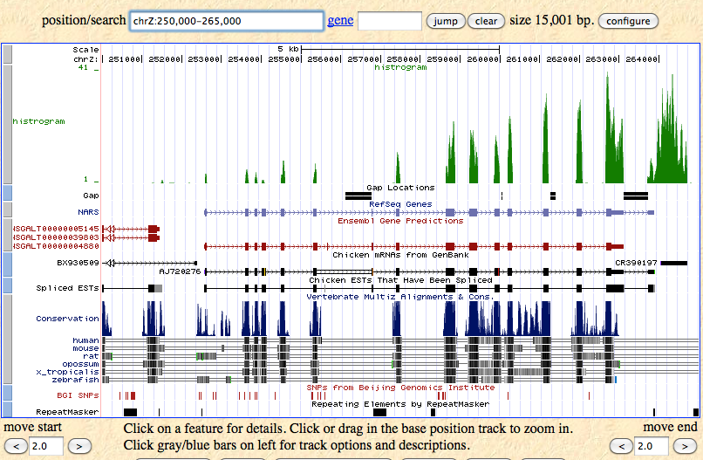
What is a genome interval?
Genes: exons, introns, UTRs, promoters (BED, GFF, GTF
Conservation (BEDGRAPH)
Genetic variation (VCF)
Sequence alignments (BAM)
Transcription factor binding sites (BED, BEDGRAPH)
CpG islands (BED)
Segmental duplications (BED)
Chromatin annotations (BED)
Gene expression data (WIG, BIGWIG, BEDGRAPH)
Your own observations: put them in context

Slide 8
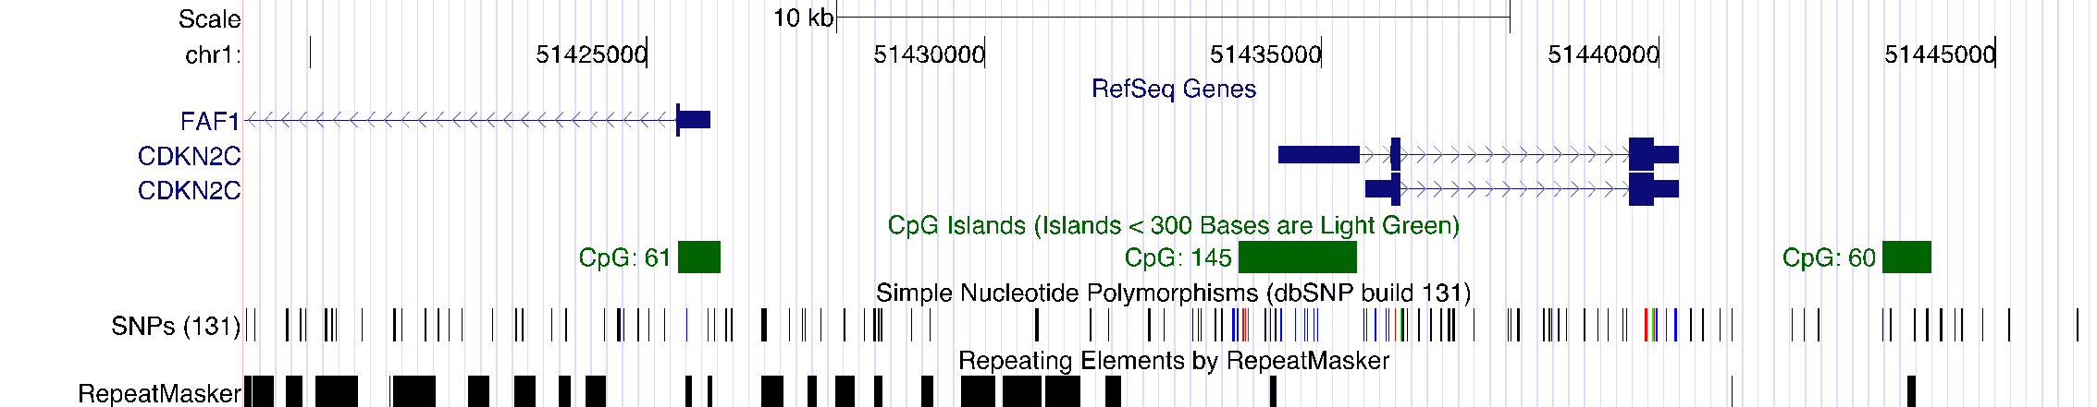
Genome intervals
Genome arithmetic: the method of comparing, contrast and gain insight among multiple genome interval files

Slide 9
Genome arithmetic depends upon the genome coordinate system
CAGTCGACATAGACTGATATGACACCACACTGAG...
chr3
0
5
10
15
20
25
chr3 0 7
chr3 4 10

Slide 10
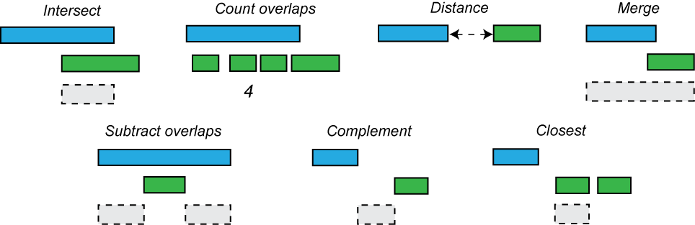
Genome arithmetic operations
0
5
10
15
20
25

Slide 11
Do two intervals intersect (overlap)?
10
20
17
27
17
27
10
20
10
20
13
16
13
16
10
20
if ((a.start <= b.start and a.end >= b.start) or
(b.start <= a.start and b.end >= a.start) or
(a.start <= b.start and a.end >= b.end) or
(b.start <= a.start and b.end >= a.end))
{
INTERSECTION!!!
}
else NADA!!!

Slide 12
Do two intervals intersect (overlap)? A simpler way.
10
20
17
27
25
27
10
20
10
20
13
16
13
16
10
20
I = min(a.end, b.end) - max(a.start, b.start)
if I > 0, intersection,
if I <= 0, distance between the intervals
= min(20, 27) - max(10, 17)
= 20-17 = 3

Slide 13
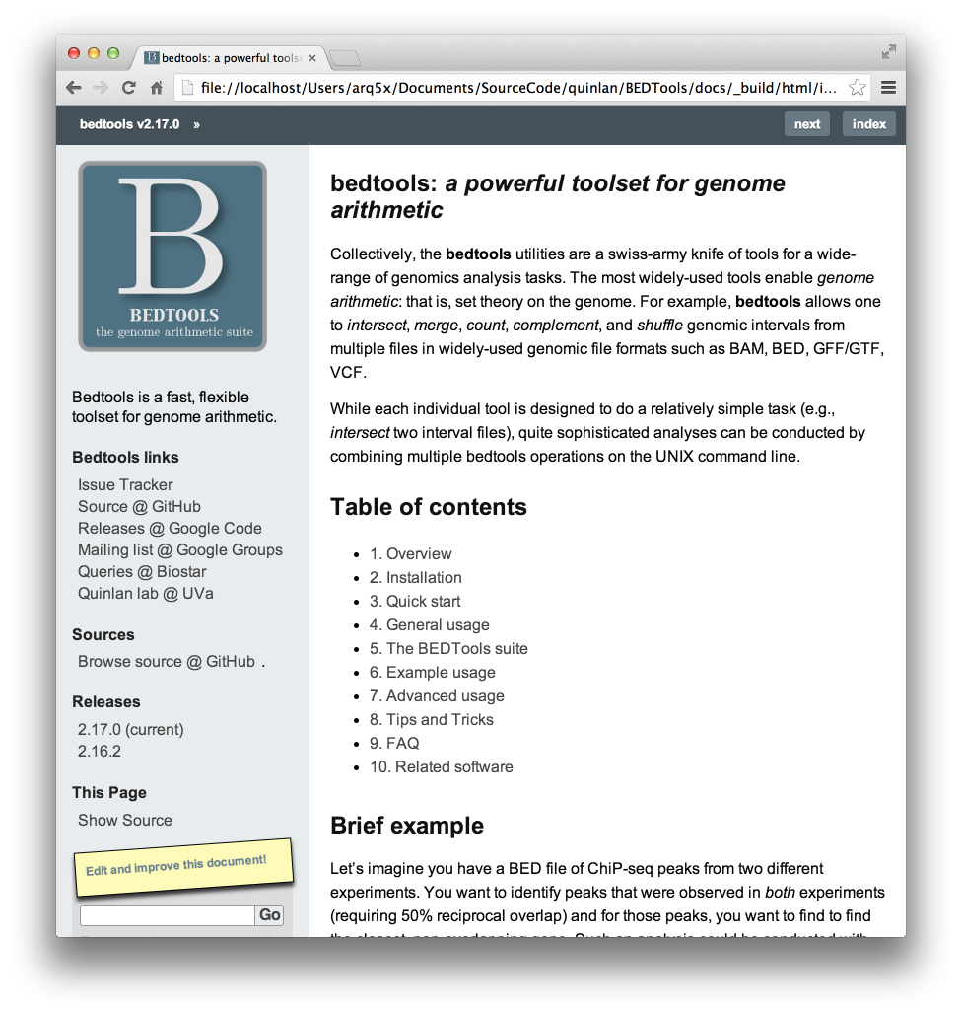
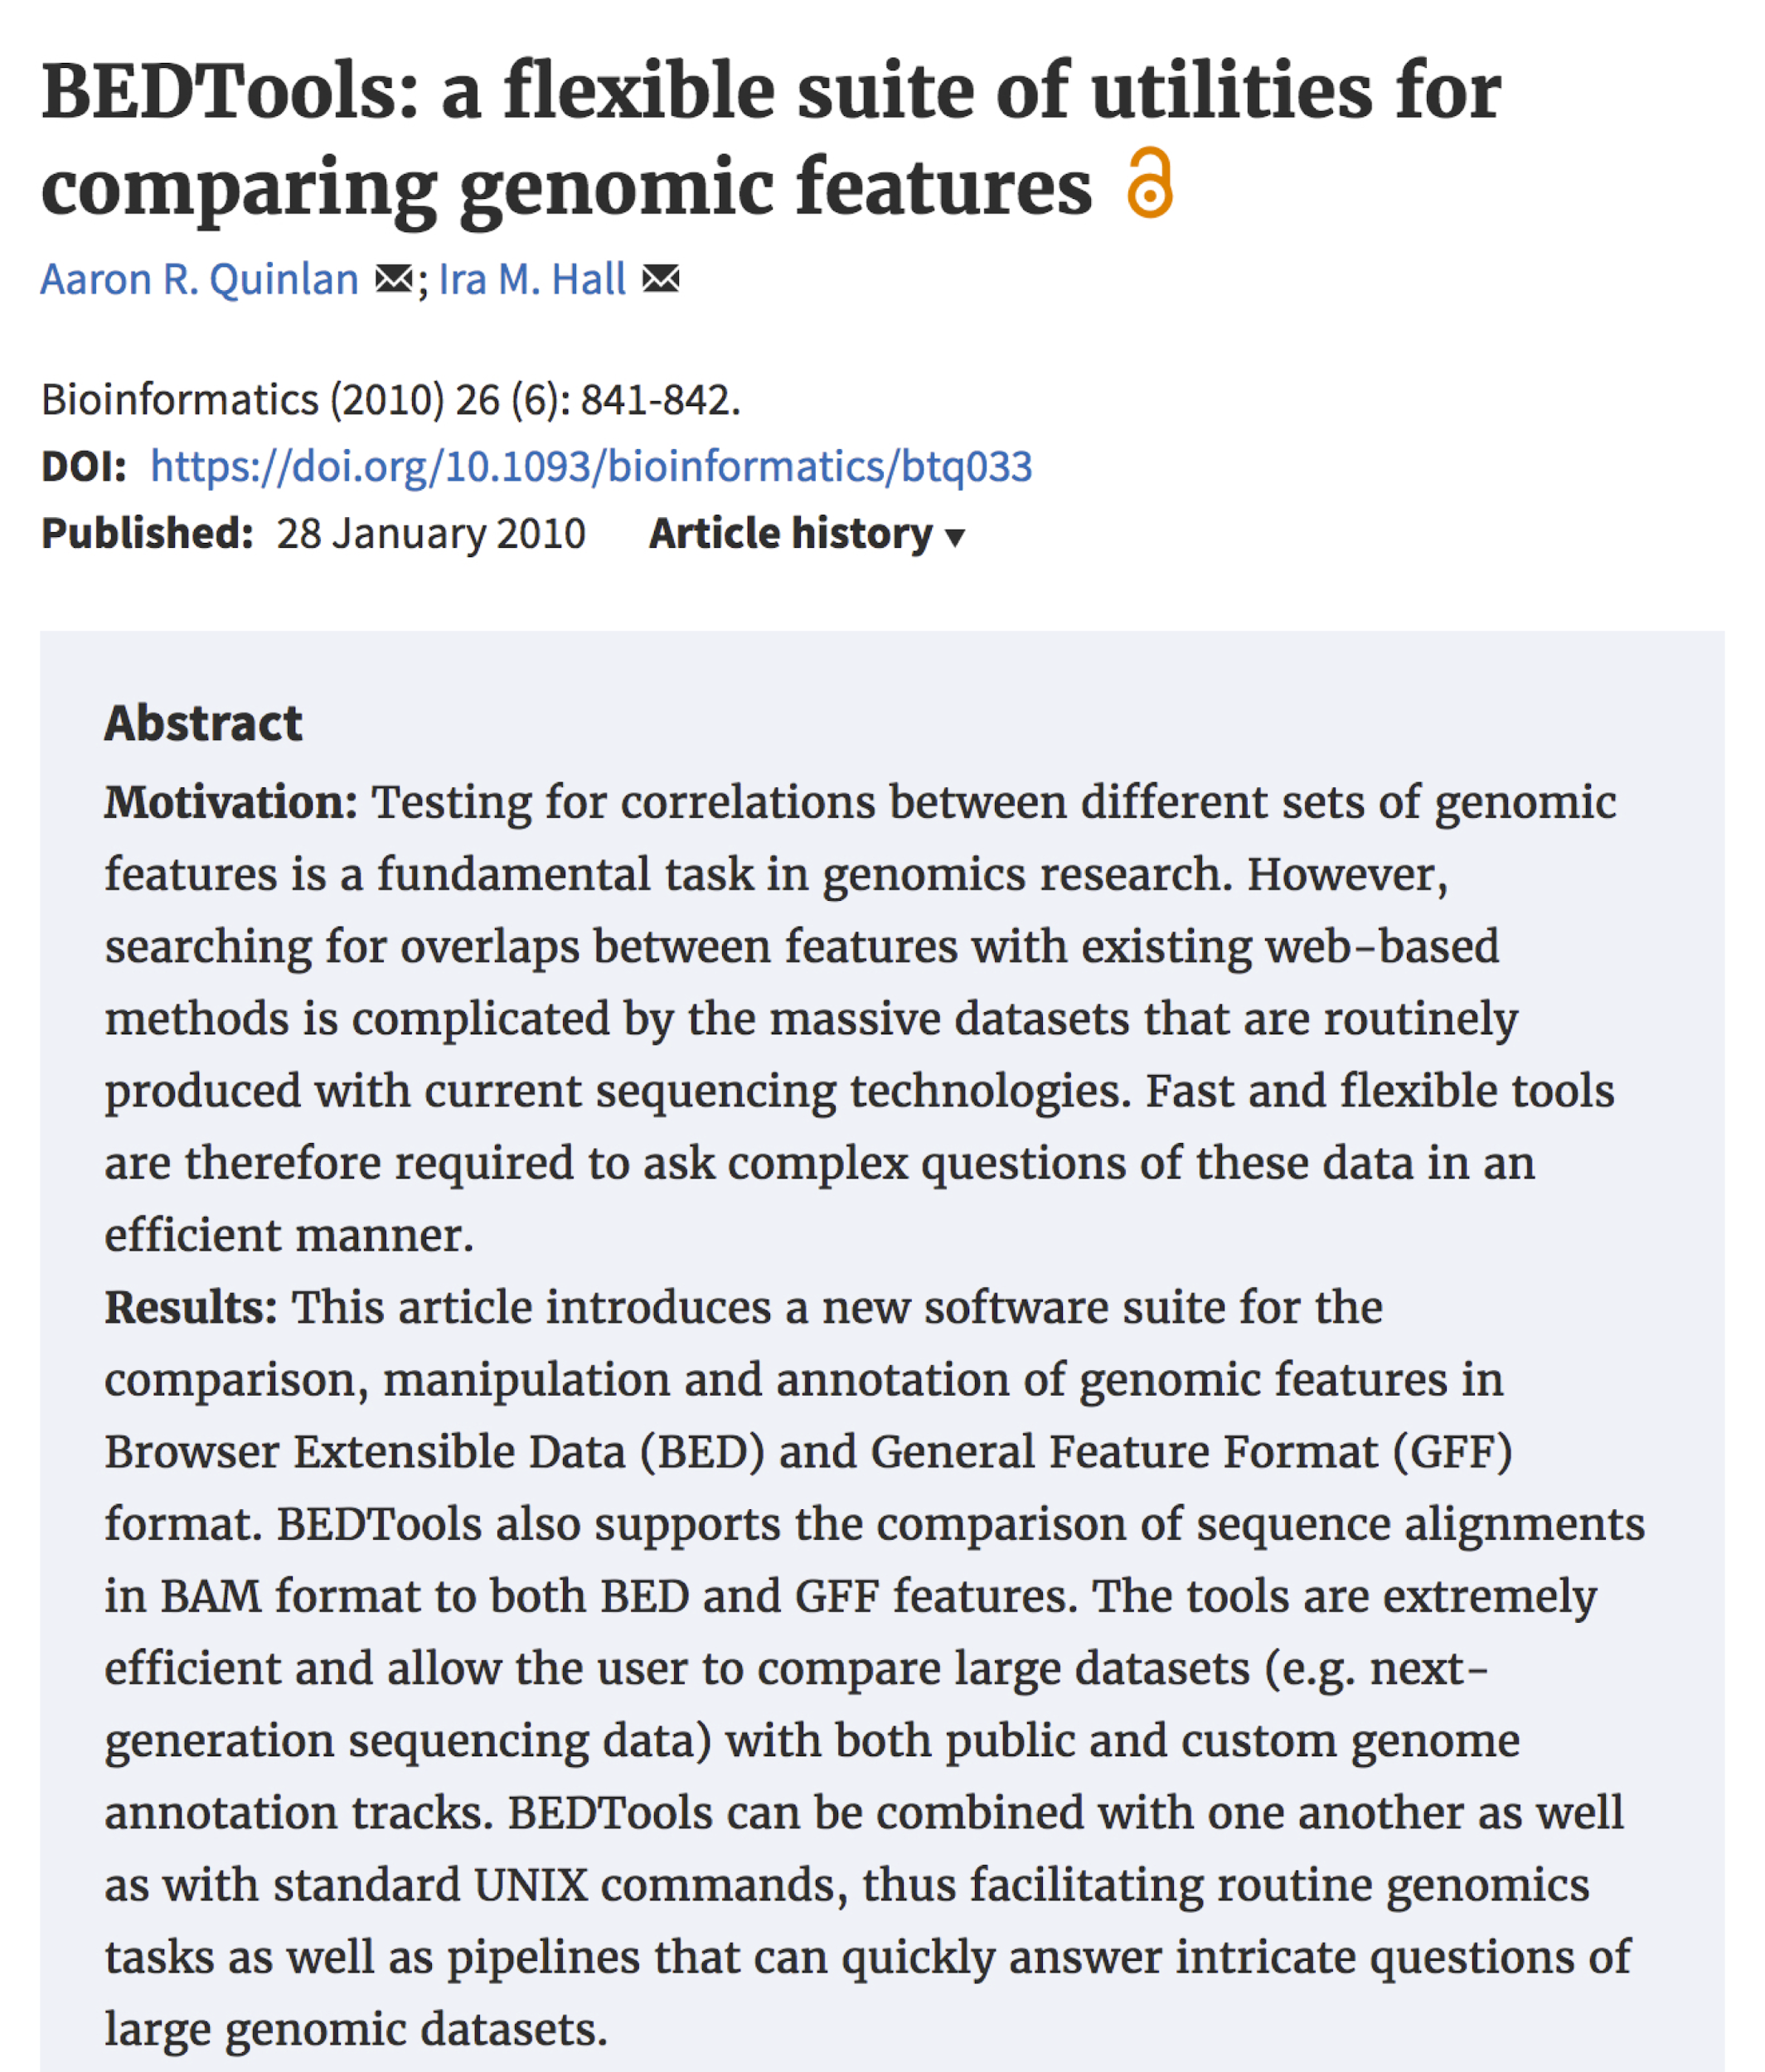

Bedtools: a swiss army knife for genome analysis
Papers:
https://doi.org/10.1093/bioinformatics/btq033
DOI: 10.1002/0471250953.bi1112s47
Documentation:
http://bedtools.readthedocs.io/en/latest/
Code:
https://github.com/arq5x/bedtools2
http://bedtools.readthedocs.io/en/latest/

Slide 14

Supports most interval formats & handles diff. coordinate systems
BED
BEDGRAPH
GFF
SAM
VCF
GTF
http://bedtools.readthedocs.io/en/latest/

Slide 15
Bedtools: example analyses
Closest gene to a ChIP-seq peak.
Is my latest discovery novel?
Is there strand bias in my data?
How many genes does this mutation affect?
Where did I fail to collect sequence coverage?
Is my favorite feature significantly correlated with some other feature?
What is the density of variants in "windows" along the genome?
http://bedtools.readthedocs.io/en/latest/

Slide 16
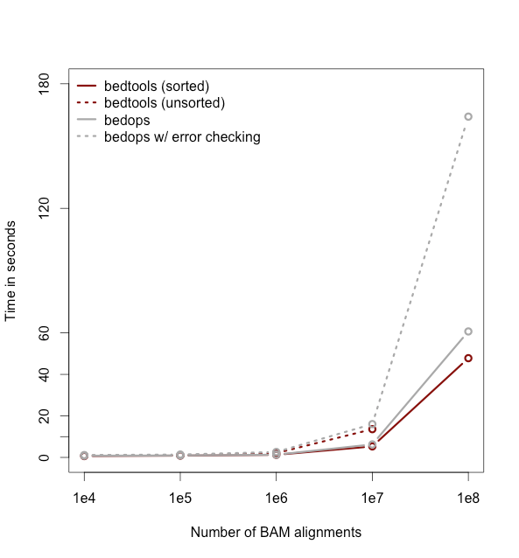
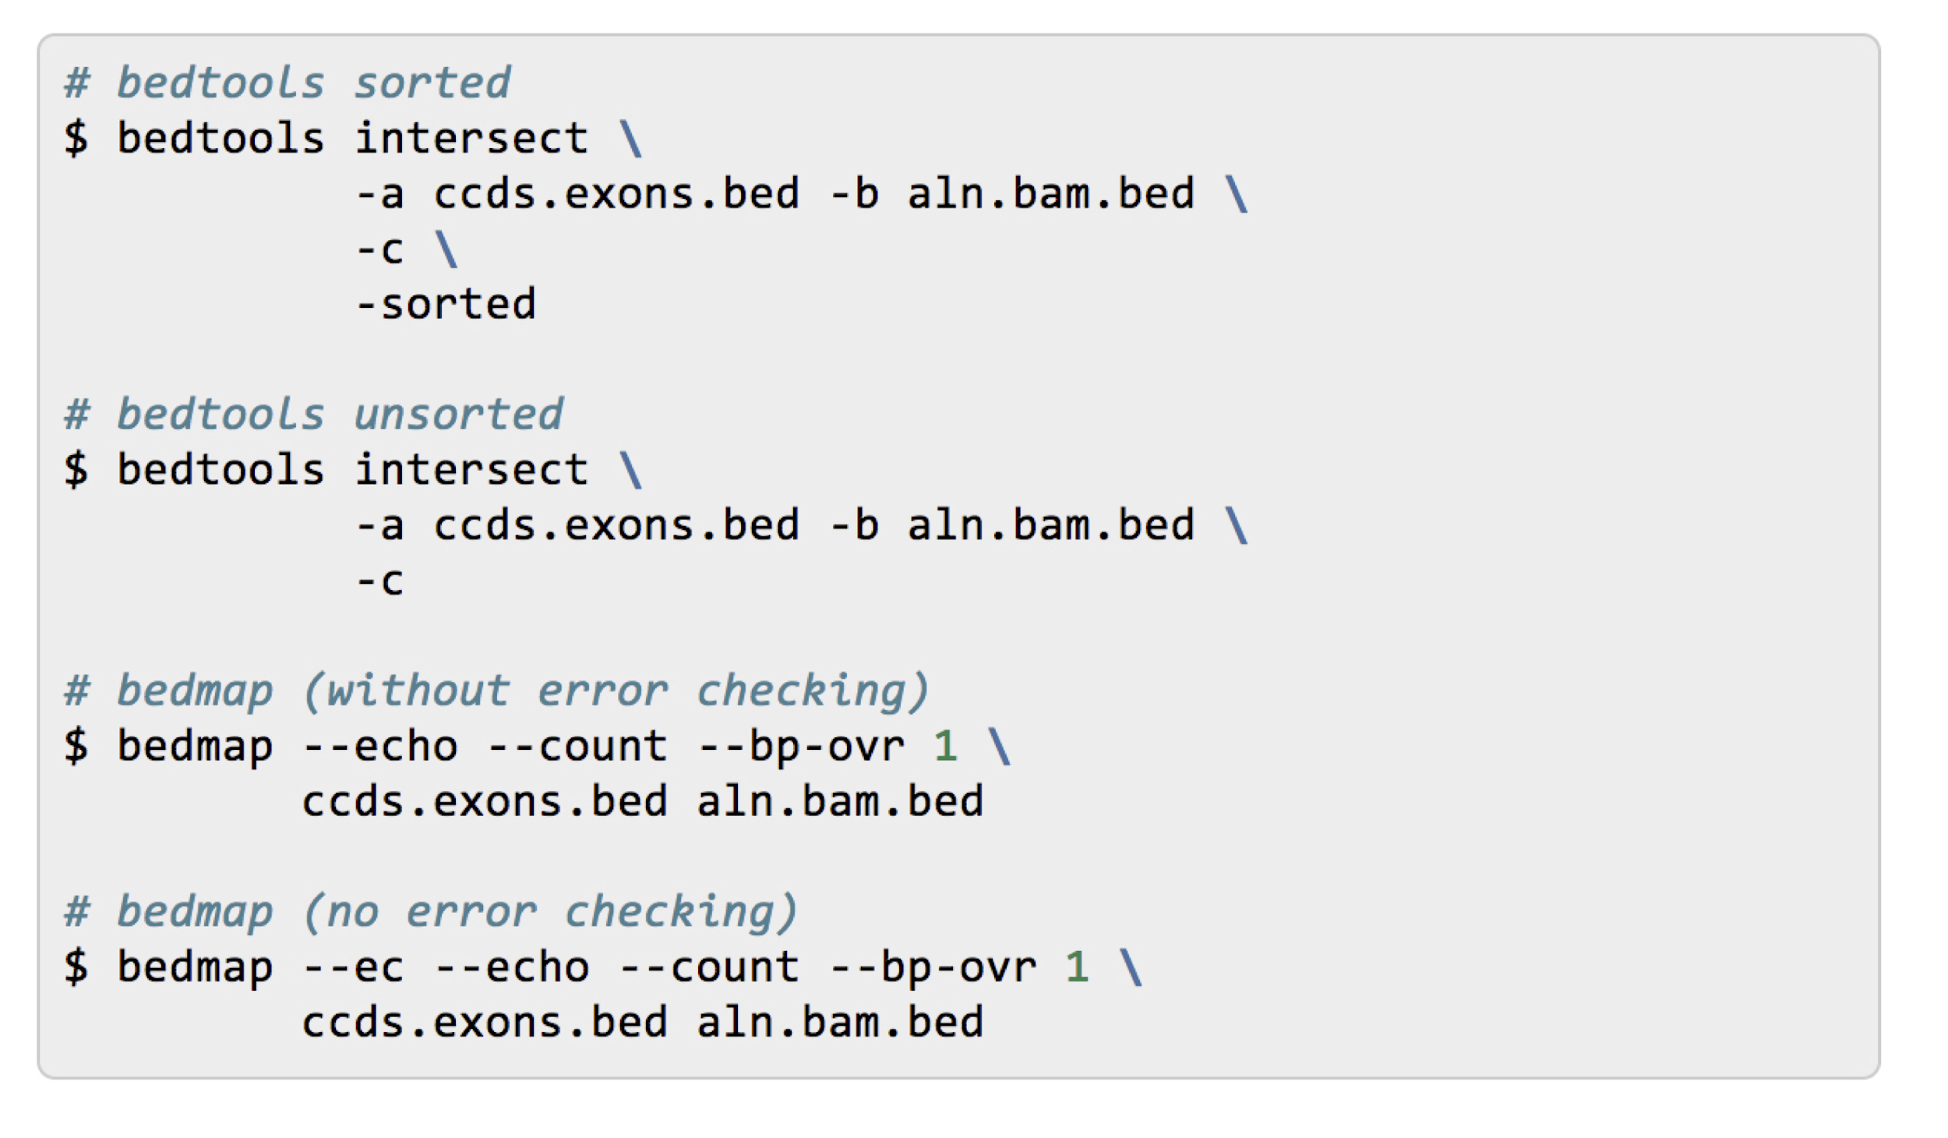
Bedtools is fairly fast.
GTF

Slide 17
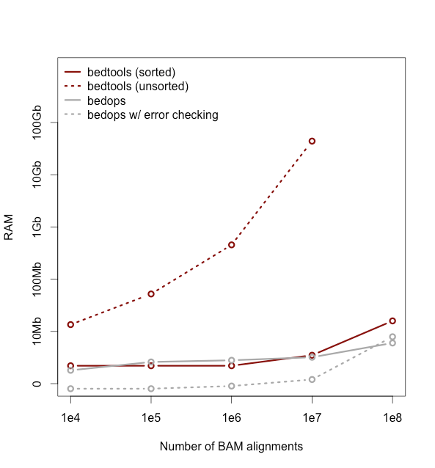
And doesn't use (too) much memory when files are "genome sorted".
Sort chromosomes lexicographically.
Then sort numerically by start coordinate
sort -k1,1 -k2,2n myfile.bed > myfile.sorted.bed

Slide 18
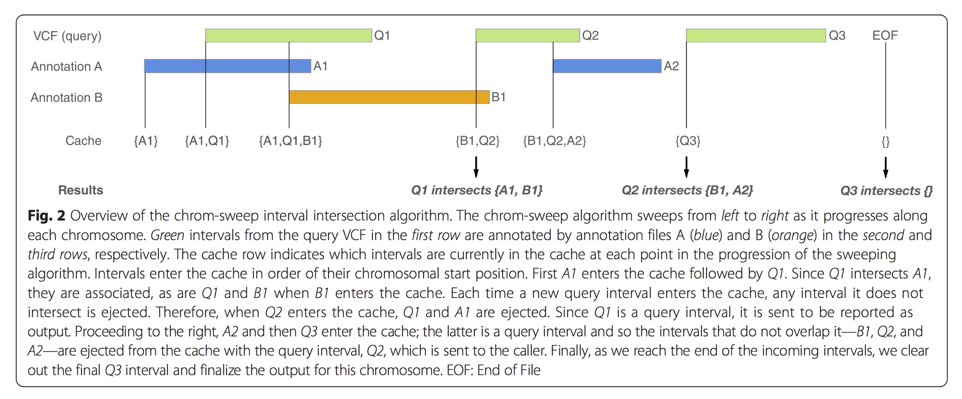
The "chromsweep" algorithm

Slide 19
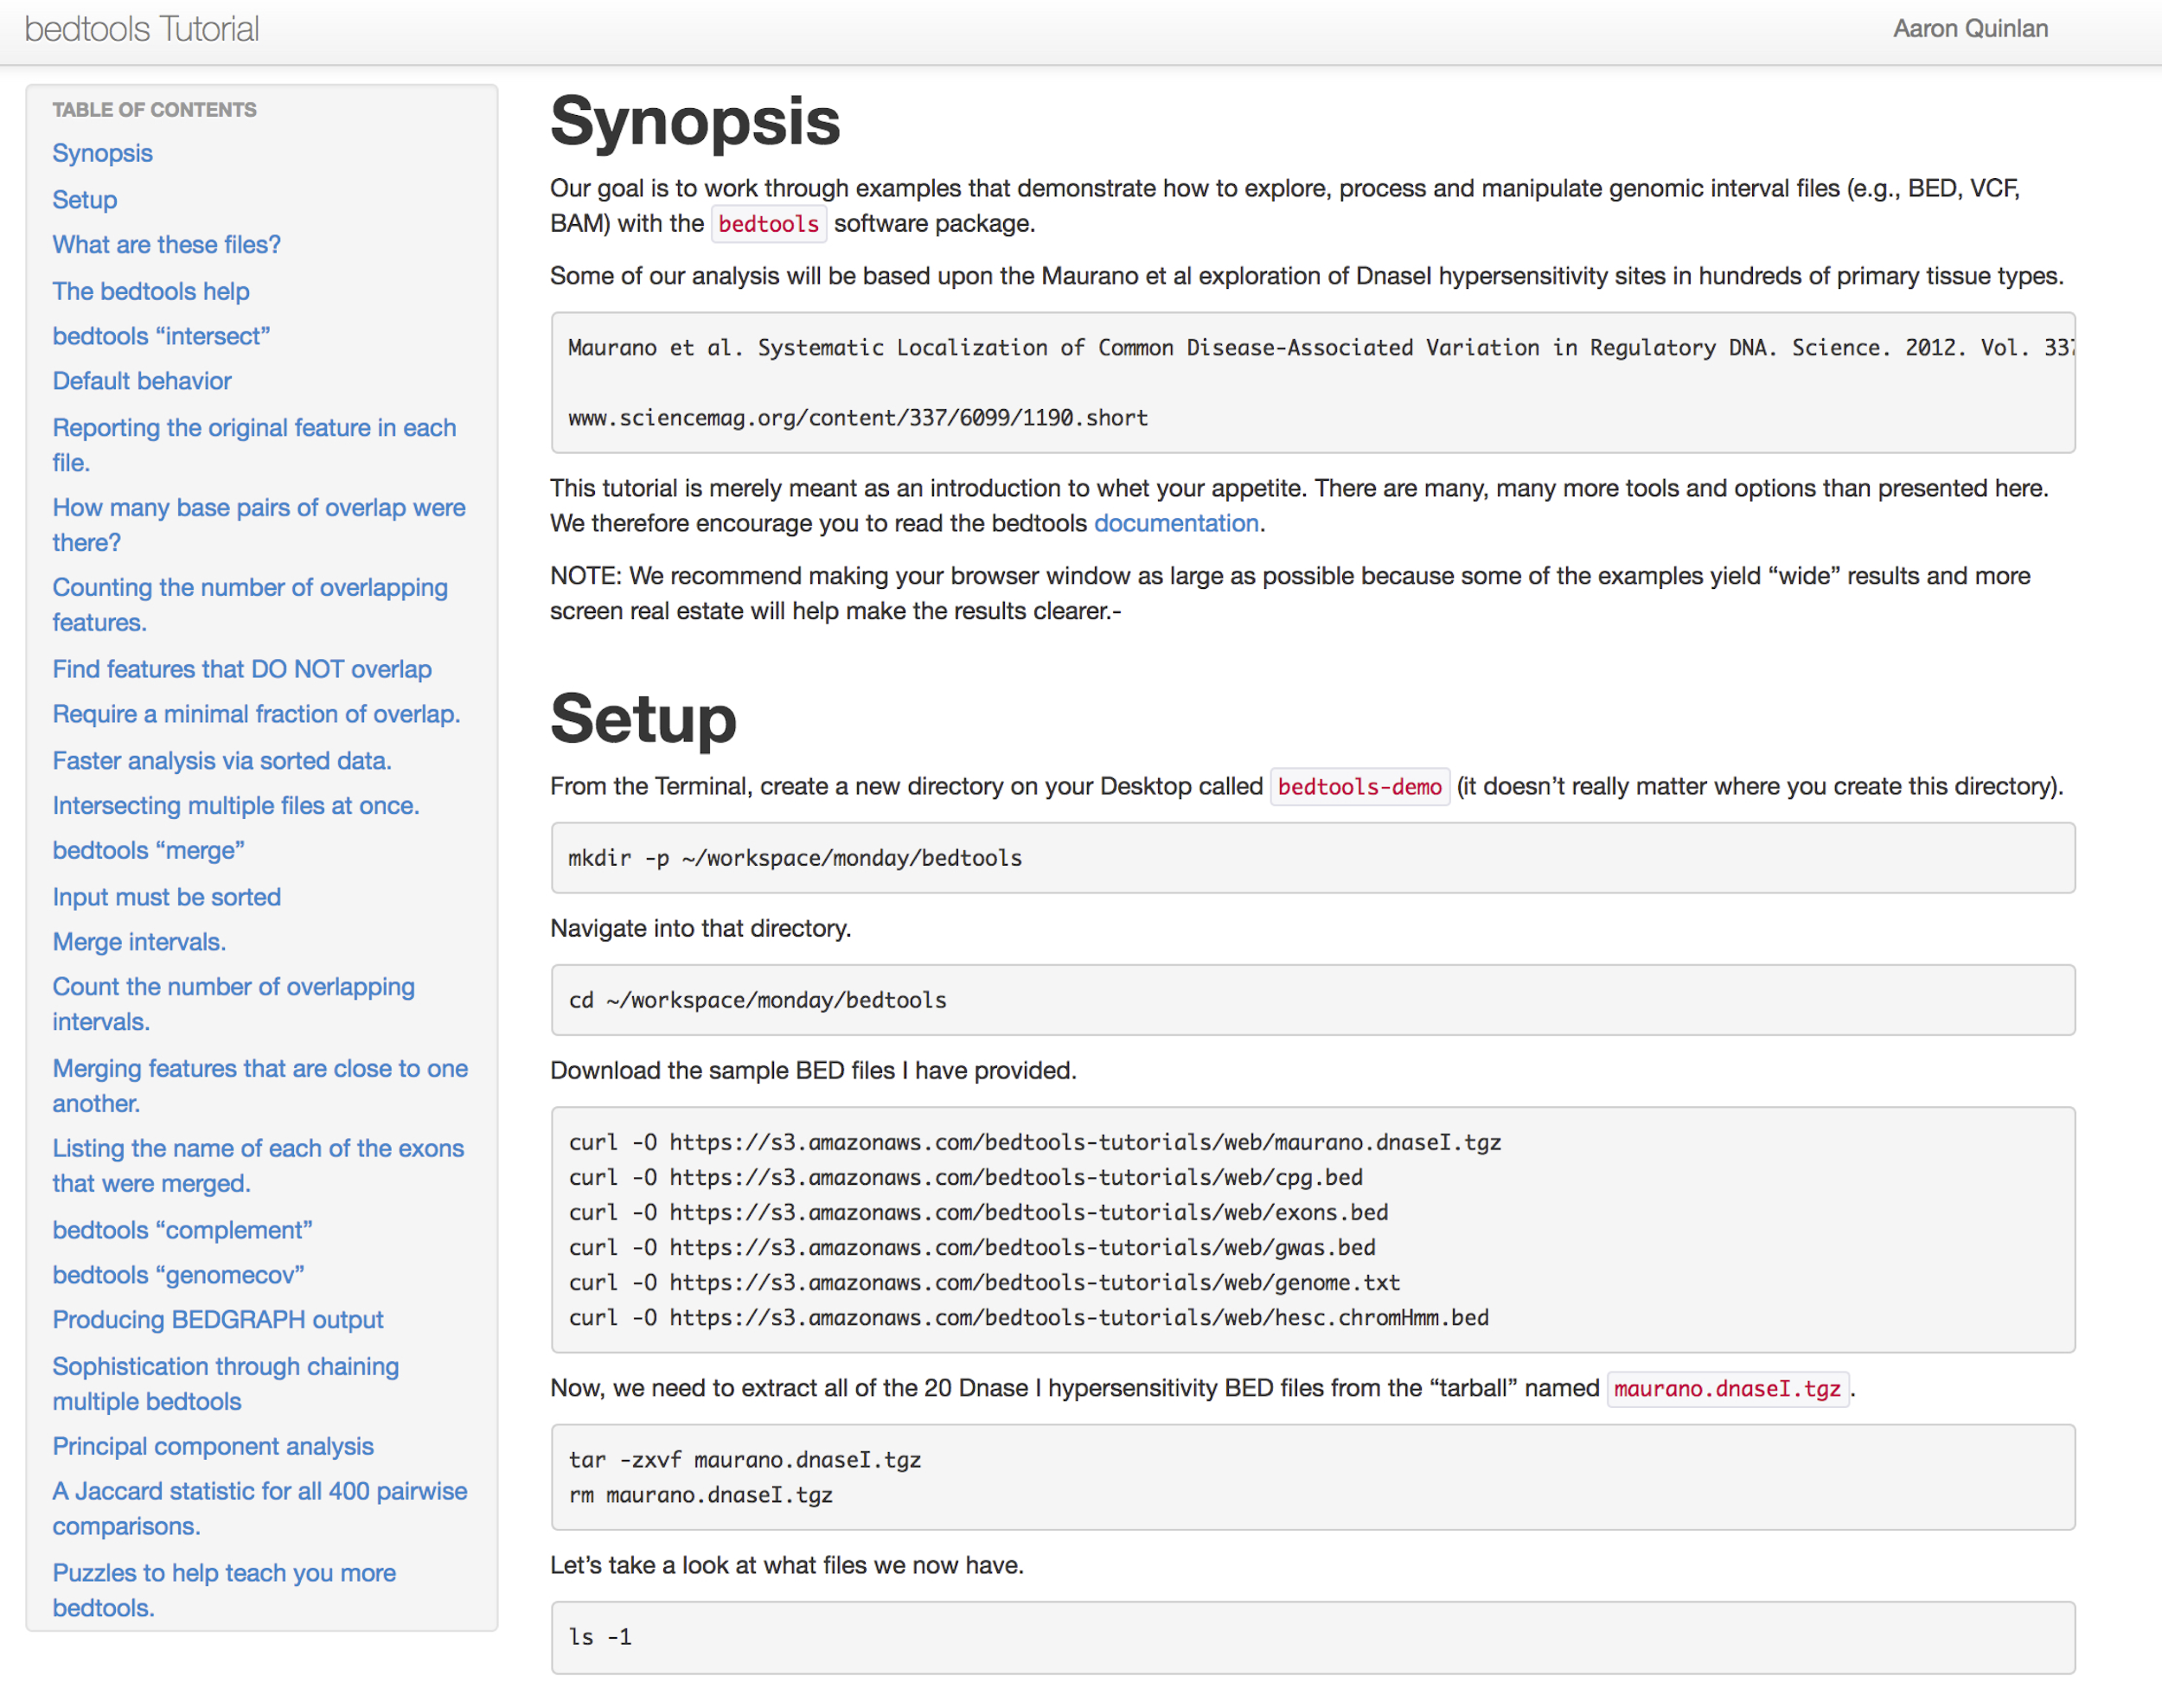
Let's work through the bedtools tutorial.
http://quinlanlab.org/tutorials/bedtools/bedtools.html
Connect to malibu.
mkdir bedtools-tutorial
cd bedtools-tutorial

